Slide 1
Security in Laserfiche
Jason Rothenberg
Presales Engineer

Slide 2
Agenda
Types of security
How to apply security
Best practices

Slide 3
Authentication
Who are you?
Notes:
The first facet of Laserfiche security is Authentication. The Authentication process is Laserfiche asking, “Who are you?” and “Do you have access?”

Slide 4
Authentication
Laserfiche Users
Windows Accounts
LDAP
Notes:
There are 3 different ways that Laserfiche can authenticate users: Using Laserfiche Trustee accounts (where a user is created in the Admin Console and given a username and password), using Windows account credentials, or using LDAP accounts
We normally recommend that Windows or LDAP Accounts are used, as this way users have fewer passwords to remember, and it makes security and administration tasks simpler. For example, when a new employee joins a company, the system administrators would only need to add a Windows Account for the new employee, which would then also grant them access to Laserfiche.

Slide 5
Authorization
What can you do?
Notes:
Once a user is authenticated, the next question becomes “what can you do” as a user? The Authorization aspect of Laserfiche security controls what users can do and see, and is extremely granular, allowing for extensive customization of security policies.

Slide 6
Authorization
Privileges
Feature Rights
Access Rights
Security Tags
Notes:
Configurable security settings include privileges, which control administrative abilities such as creating new user accounts, creating and editing templates, and permanently purging entries; feature rights, which control access to functionality such as scanning, searching, and exporting; access rights, which affect user’s abilities to view and alter specific repository entries, fields, templates, and volumes; and security tags, which provide a heavily restrictive way of only allowing entry access to a file or folder to a specific user.
Mention where these are set

Slide 7
Authorization
Group 1
Group 2
Notes:
Not only are security settings available to assign to individual users, but groups can also be created to apply security to a set of users at once. An individual can also belong to more than one group, and have sum of the rights and privileges assigned to their groups.
Change this to visually show groups

Slide 8
Entry Access Rights

Slide 9
To Allow or Not To Allow
Allow
Not Allow (Blank)
Deny
  Deny overrides Allow
Tip
  Use “Not Allow” instead of “Deny”

Slide 10
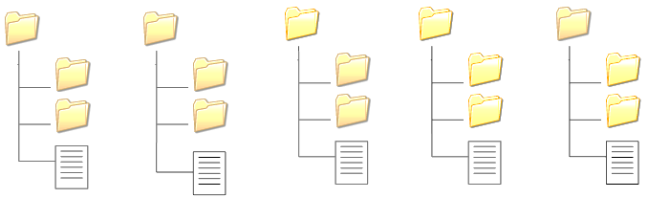
Scope – Access Inherited
This folder, subfolder and documents
This folder and subfolders
Subfolders and documents only
Documents only
This entry only
Notes:
So there are several options to use with scope and each one has its own purpose. For example, maybe you want some users to be able to see all folders and subfolders and documents, while you only want others to see that folder and subfolders.

Slide 11
Order of Precedence
Inherited rights vs. Explicit rights
←Allow (Folders, subfolders and docs)
←Allow (inherited)
←Allow (inherited)
←Allow (inherited)
Notes:
Now bear with me as I cover one more topic that deals with this.

Slide 12
Order of Precedence
Inherited rights vs. Explicit rights
Explicit rights will take precedence over inherited rights
←Allow (Folders, subfolders and docs)
←Allow (inherited)
←Allow (inherited) Denied (Explicit)
←Allow (inherited) Denied (Explicit)
Notes:
Now bear with me as I cover one more topic that deals with this.

Slide 13
Making sense of
Inherited vs. Explicit Rights

Slide 14
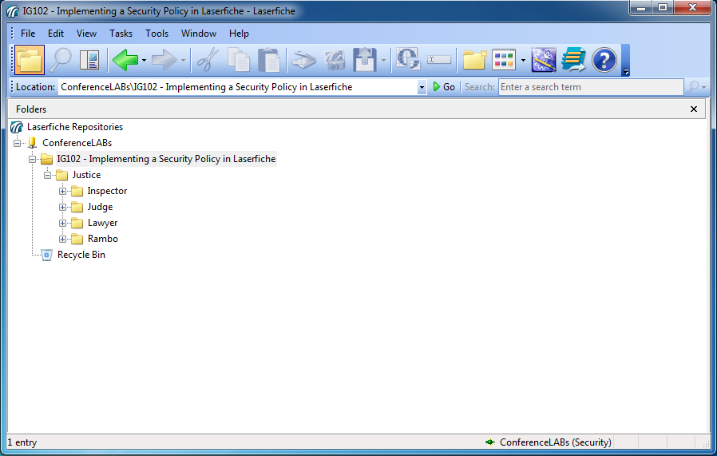
Inherited Allow, Explicit Deny
Inspector allowed at Justice folder, subfolders and docs
Inspector denied at Judge’s folder
Notes:
So let’s see this in action

Slide 15
Inherited Allow, Explicit Deny
Inspector allowed at Justice folder, subfolders and docs
Inspector denied at Judge’s folder
Conclusion: Inspector cannot see Judge’s folder

Slide 16
Inherited Deny, Explicit Allow
Inspector denied at Justice Folder
Inspector allowed at his folder

Slide 17
Inherited Deny, Explicit Allow
Conclusion: Inspector cannot browse to his folder. But he can search for his folder.

Slide 18
Scope Best Practices

Slide 19
Order of Precedence
Goal: Let each user see their own folder

Slide 20
Order of Precedence
Justice group is allowed at Justice Folder, and scope is “This Entry Only”

Slide 21
Order of Precedence
Justice group is allowed at Justice Folder, and scope is “This Entry Only”
Inspector allowed at his folder
Judge allowed at his folder
Lawyer allowed at his folder
Rambo allowed at his folder

Slide 22
Order of Precedence
Justice group is allowed at Justice Folder, and scope is “This Entry Only”
5 steps
Inspector allowed at his folder
Judge allowed at his folder
Lawyer allowed at his folder
Rambo allowed at his folder

Slide 23
Clashing Access Rights
Group and User
Order of Precedence
  Deny overrides Allow/Not Allow
  Allow overrides Not Allow

Slide 24
Order of Precedence
Which right takes priority?
- Explicit Access Rights
  Deny, Allow, or None
User allowed and group denied = user denied

Slide 25
Order of Precedence
Which right takes priority?
- Explicit Access Rights
  Deny, Allow, or None
User allowed and group denied = user denied
User denied and group allowed = user denied

Slide 26
Order of Precedence
Which right takes priority?
- Explicit Access Rights
  Deny, Allow, or None
User allowed and group denied = user denied
User denied and group allowed = user denied
User allowed, group not allowed = user allowed

Slide 27
Order of Precedence
Which right takes priority?
- Explicit Access Rights
  Deny, Allow, or None
User allowed and group denied = user denied
User denied and group allowed = user denied
User allowed, group not allowed = user allowed
User allowed, group allowed = user allowed

Slide 28
2 Methods for Security
Allow all, then deny
Not allow, then allow
Tip
  Not allow, then allow
  Use Scope and “This Entry Only”

Slide 29
Security Tags
Notes:
Follow the guide

Slide 30
Security Tags
Security tags offer flexible security
Tags must be assigned to user
Users can only use assigned tags
Only users with tag can see document

Slide 31
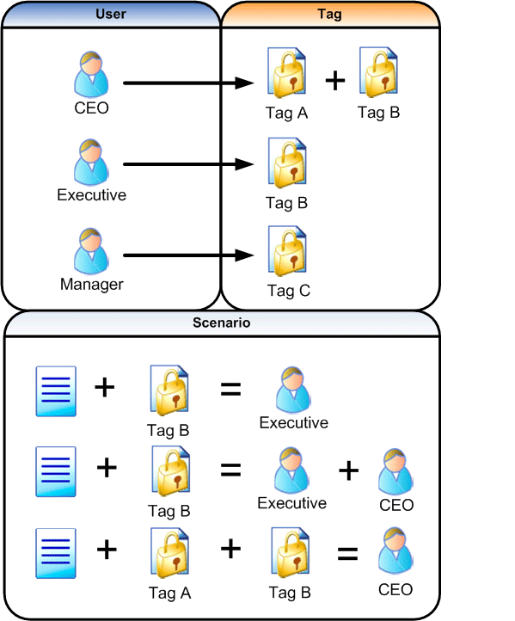
Security Tags

Slide 32
Security Tags

Slide 33
Security Tags

Slide 34
Security Tags

Slide 35
Security Tags

Slide 36
Security Tags

Slide 37
Metadata Access Rights

Slide 38
Field Security Rights
Read
Create Applicable to filling out fields
Edit
Modify Field
Delete Field
Read Security
Modify Security
} Field management
} Access management

Slide 39
Template Security Rights
Read Template
Modify Template
Delete Template
Read Template Security
Change Template Security

Slide 40
Volume Security Rights

Slide 41
Volume Security Rights
  Manage Volumes
  Delete Volume
  Read Volume Security
  Change Volume Security

Slide 42
Takeaways
Use groups efficiently
Easily administer security
Don’t get deny happy
Successfully secure your repository

Slide 43
Questions?
Notes:
Before we begin the lab portion of this class, are there any questions?

Slide 44
Security Resources
Online Help Files:
  Security Administration
White Papers:
  Best Practices in Laserfiche Security
Notes:
End your presentation on this slide, but remember to ask for questions.
Resources: List other courses, papers, videos, etc., relevant to your course material.

