Slide 1
Overview of Laserfiche Architecture

Slide 2
Agenda
Parts of Laserfiche
Big picture
Splitting up the workload
Best Practices
Notes:
We’re going to start small- the parts of the document- and work our way up to enterprise setups.

Slide 3









Architecture
Tt
Notes:
If you take a look, most of the big products are here. Don’t worry too much about this whole craziness yet- we’ll be tackling it in pieces. This is what we’re working up to though. You might not be familiar with some of these icons yet; that’s alright, they’ll be labeled as we go along. We’re going to start with the lowly document and work our way up to the whole shebang.

Slide 4
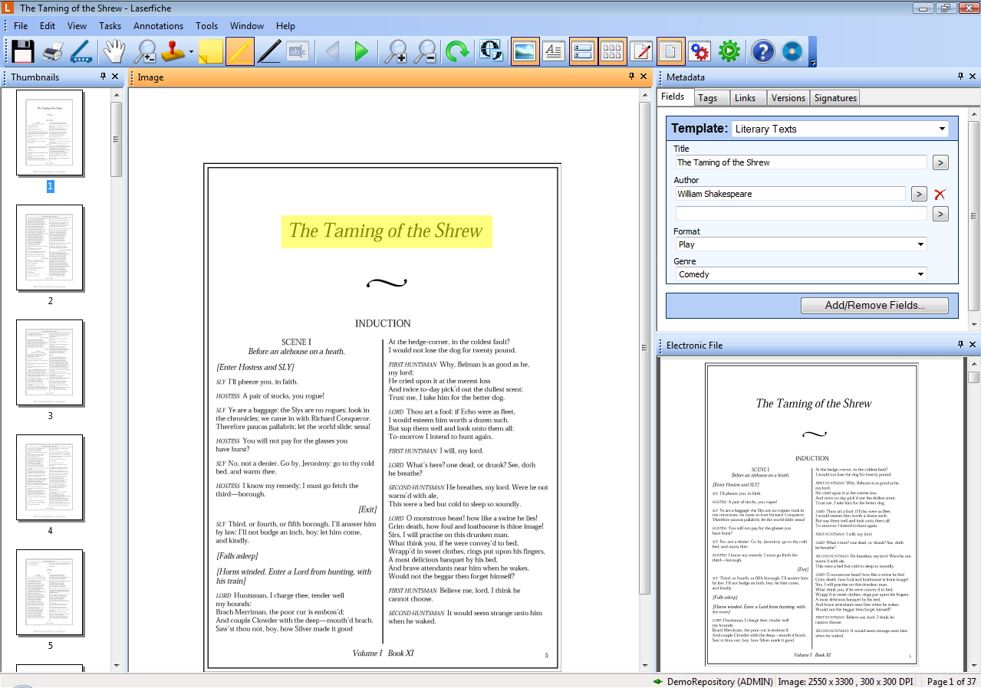

Slide 5




What’s in a document?
Pages
Metadata
eDoc
Annotations
Thumbnails

Slide 6
Annotations
Metadata
Pages
eDoc
Thumbnails

Slide 7

Repository
Volumes
Database
Audit Logs
LFFTS Catalog
Tt
Tt

Slide 8
Architecture
Server
Repository
Audit Trail
LFFTS Engine
Tt

Slide 9
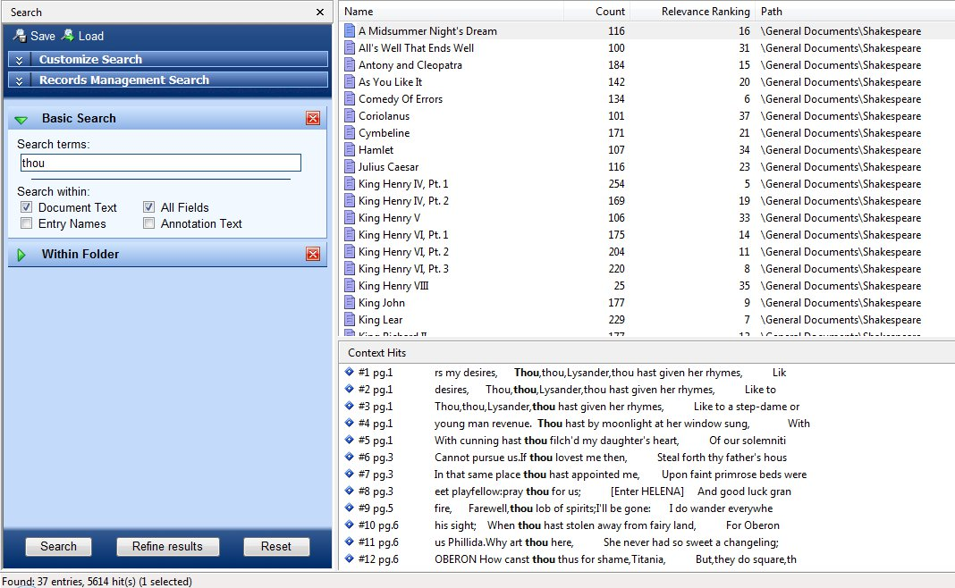
LFFTS Engine

Slide 10
Architecture
Tt
Notes:
If you take a look, most of the big products are here. Don’t worry too much about this whole craziness yet- we’ll be tackling it in pieces. This is what we’re working up to though. You might not be familiar with some of these icons yet; that’s alright, they’ll be labeled as we go along. We’re going to start with the lowly document and work our way up to the whole shebang.

Slide 11
Client Applications
Tt

Slide 12
Desktop Client Applications
Quick Fields
Client
Tt

Slide 13
Desktop Client Applications
Tt

Slide 14
Web Client Applications
Web Link
Web Access
Laserfiche Forms
Tt

Slide 15
Web Client Applications
Web Servers
Tt

Slide 16
Web Client Applications
Tt

Slide 17
Workflow
Workflow Server
Workflow Subscriber
Tt

Slide 18
Workflow
Tt

Slide 19
Avante
Tt

Slide 20

Rio
License Manager
Tt
Tt
Tt
Notes:
License manager allows you to manage your user licenses at the system level instead of on a per-repository basis. This means that windows users can use one license to access these three servers

Slide 21

Architecture
How does it all talk?
  HTTP
  SSL
    Web Browser to Web Server
    Application to server
Notes:
Server mainly communicates with HTTP
Default ports, available on Support Site

Slide 22
Distributing the Workload
Why distribute?
How do I distribute?

Slide 23
Distributing the Workload
Why distribute?
  Performance
  Scalability
How do I distribute?

Slide 24
Distributing the Workload
Why distribute?
How do I distribute?
  DBMS
  Laserfiche Server
  Full Text Search Engine
  Workflow Server

Slide 25
Distributing the Workload
Why distribute?
How do I distribute?
OCR distribution:
  Distributed Processing

Slide 26
Backup
Backup, backup, backup
Probably should also back up this stuff
Test your backup

Slide 27
Backup
Backup, backup, backup
  Volumes
  Databases
  Audit logs
  Workflow definitions
Probably should also back up this stuff
Test your backups

Slide 28
Backup
  Backup, backup, backup
  Probably should also back up this stuff
    QF sessions
    Named user database
    Search catalog
  Test your backups

Slide 29
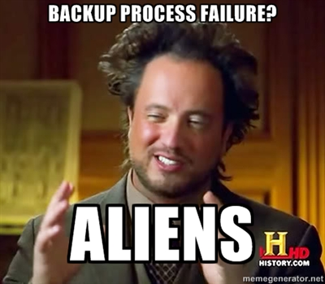
Backup
Backup
  Backup, backup, backup
  Probably should also back up this stuff
  Test your backup

Slide 30
Upgrading
Upgrading
  From 8 to 9
    Let the installer do it
  From 7 to 9
    Migration Utility
Notes:
Upgrading from version 7 or earlier to 8 or 9 requires modification of the existing database. The migration utility, available on the support site, makes these edits

Slide 31
Questions?

